Slide 1


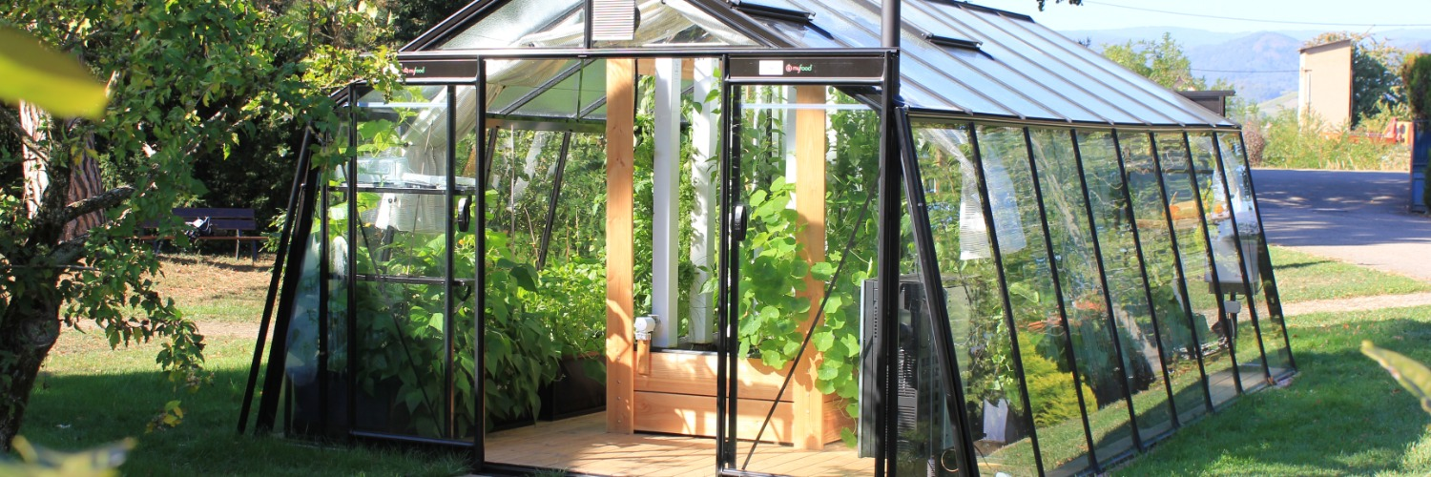


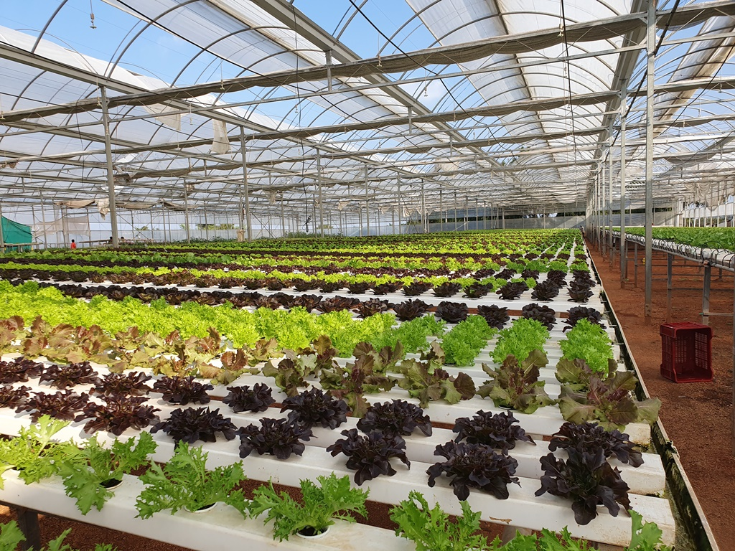
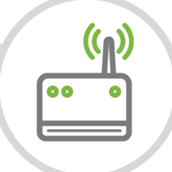
INSTITUTE OF TECHNOLOGY OF CAMBODIA
Department of Telecommunication and Network Engineering
MULTI-FUNCTION TESTER
INTRODUCTION
Agriculture in Cambodia is currently evolving to more technology. Because it’s hard to plant as traditional ways and also get less yields. So, farmer is trying to convert their farm into technology as much as they can such as, growing plants in greenhouse that can use wireless control. The main things that famer want to control for plant in their farm are Humidity, Temperature, Moisture and Soil’s pH, also it’s so difficult to control or get data of them. Our project is a part of Agriculture and Technology. We create this project for support to farmer to control those things in their farm or greenhouse. Because plants need the specific temperature, humidity and moisture. So, we need to help them to get more specific of it by create a Multi-Function Tester.
SENSOR
P ROJECT
Multi-Function Tester is an object that can collect data of temperature, humidity, moisture and soil’s pH from the environment around it. We invented Multi-Function Tester with one micro-controller and 3 sensors on it. Multi-Function Tester also can be weather station and test-toolkit too. It’s small and we can it with battery and power supply. So, it’s easier for famer to use it. In the future we will convert it to IoT so, famer can get data from their farm at anytime and anywhere. We will also invent an auto-irrigation system with Multi-Function Tester too. Because it has temperature and humidity data so, it is easier to control irrigation system.
Hum:%
Temp:°C
pH
Moi:%
CONTACT
LECTURE: HEL Chanthan
CHHORN Sopheaktra
TEP Sovichea
STUDENT: NHIM Chanrengsey
Email: nhimchanrengsey@gmail.com
Tel: 070562483
GitHub: https://github.com/Chanthan89/Smart-Irrigation/tree/master/Multi-Function%20Tester

Slide 2
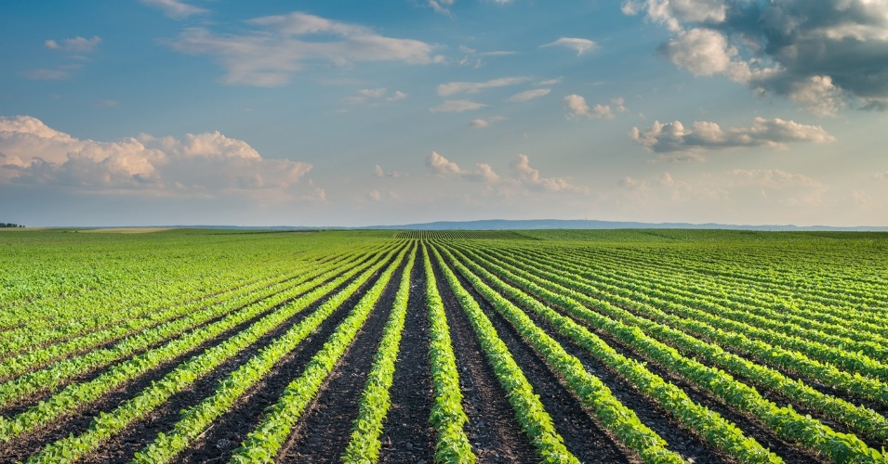
INSTITUTE OF TECHNOLOGY OF CAMBODIA
Department of Telecommunication and Network Engineering
MULTI-FUNCTION TESTER
INTRODUCTION
Agriculture in Cambodia is currently evolving to more technology. Because it’s hard to plant as traditional ways and also get less yields. So, farmer is trying to convert their farm into technology as much as they can such as, growing plants in greenhouse that can use wireless control. The main things that famer want to control for plant in their farm are Humidity, Temperature, Moisture and Soil’s pH, also it’s so difficult to control or get data of them. Our project is a part of Agriculture and Technology. We create this project for support to farmer to control those things in their farm or greenhouse. Because plants need the specific temperature, humidity and moisture. So, we need to help them to get more specific of it by create a Multi-Function Tester.
SENSOR
P ROJECT
Multi-Function Tester is an object that can collect data of temperature, humidity, moisture and soil’s pH from the environment around it. We invented Multi-Function Tester with one micro-controller and 3 sensors on it. Multi-Function Tester also can be weather station and test-toolkit too. It’s small and we can it with battery and power supply. So, it’s easier for famer to use it. In the future we will convert it to IoT so, famer can get data from their farm at anytime and anywhere. We will also invent an auto-irrigation system with Multi-Function Tester too. Because it has temperature and humidity data so, it is easier to control irrigation system.
Hum:%
Temp:°C
pH
Moi:%
CONTACT
LECTURE: HEL Chanthan
CHHORN Sopheaktra
TEP Sovichea
STUDENT: NHIM Chanrengsey
Email: nhimchanrengsey@gmail.com
Tel: 070562483
GitHub: https://github.com/Chanthan89/Smart-Irrigation/tree/master/Multi-Function%20Tester

